Slide 1
Data Structure Optimization for Power-Efficient IP Lookup Architectures
Author:
Weirong Jiang and Viktor K. Prasanna
Publisher:
IEEE TRANSACTIONS ON COMPUTERS, 2012
Presenter:
Li-Hsien, Hsu
Data:
10/03/2012

Slide 2
Introduction(1/4)
the main focus of this paper is on designing power-efficient SRAM-based IP lookup engines.
The main contributions of this paper include a thorough study on the impact of the data structure tuning of a multi-bit trie on the power consumption of SRAM-based IP lookup architectures.

Slide 3
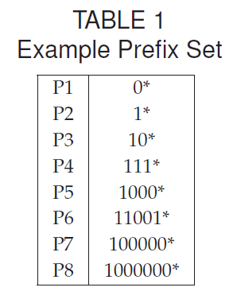
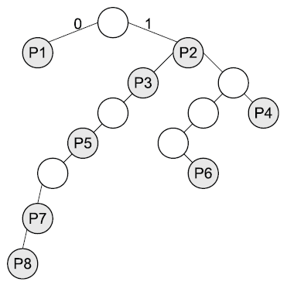
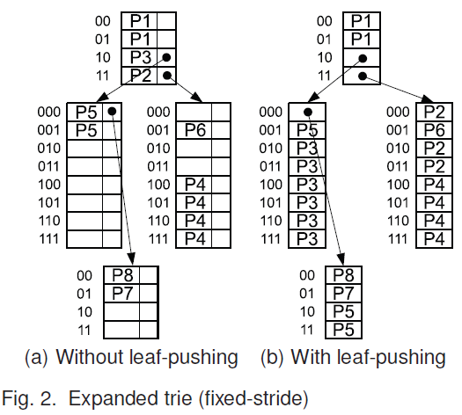
Introduction(2/4)
Two existing multi-bit trie algorithms are studied.
  expanded trie
  tree bitmap trie

Slide 4
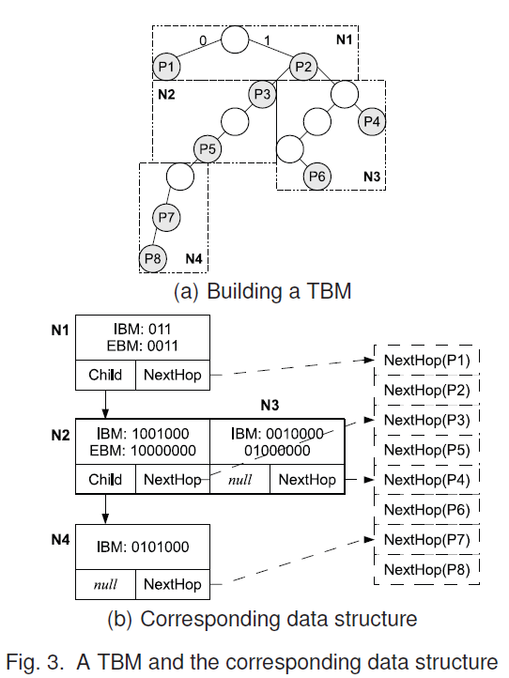
Introduction(3/4)

Slide 5
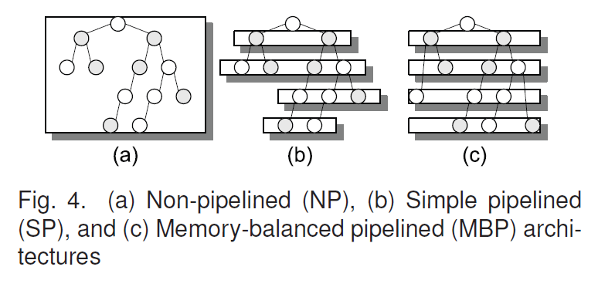
Introduction(4/4)
Three different IP lookup architectures are discussed: non-pipelined, simple pipelined and memory-balanced pipelined architectures.

Slide 6
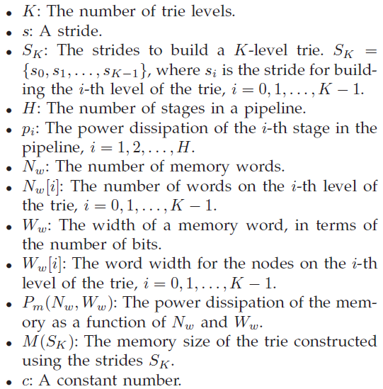
Notations

Slide 7
Assumption
The main focus of this paper is on reducing the power consumption caused by memory accesses. The power dissipation due to the logic will be ignored in the rest of the paper.

Slide 8
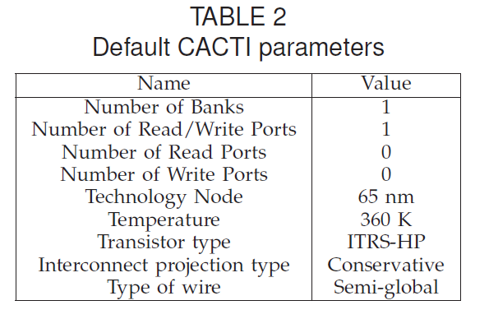
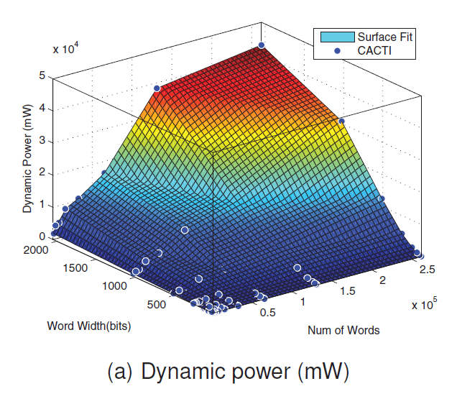
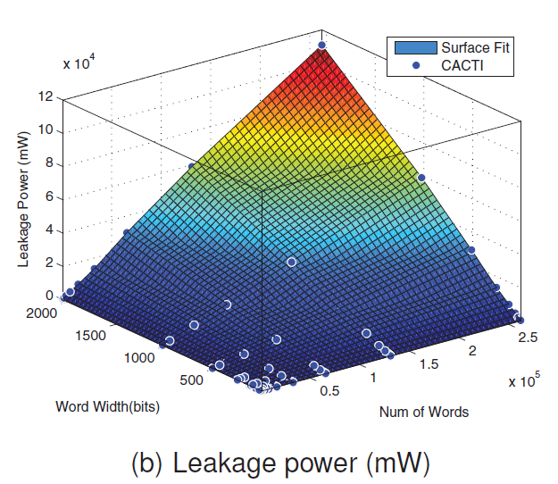
Power function of SRAM

Slide 9
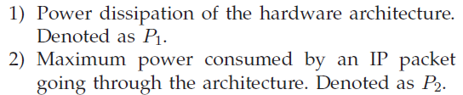
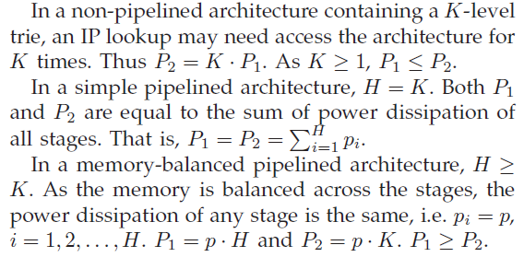
Power consumption of metrics

Slide 10
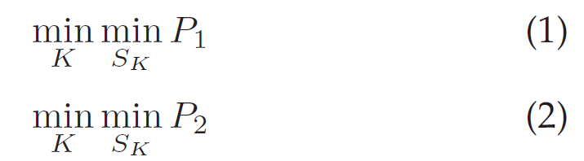
Problem of Power Minimization
We aim to minimize the power consumption of SRAM-based IP lookup architectures by choosing the optimal strides in building a fixed-stride multi-bit trie.

Slide 11
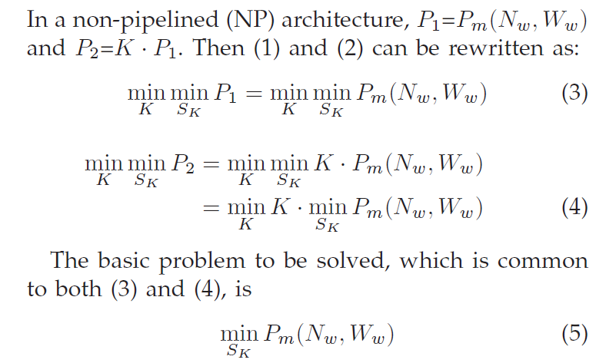

Problem of Power Minimization(NP)
the word width of the memory has to be identical and should be determined by the largest word width across all levels of the trie. In other words,
Notes:
改寫

Slide 12
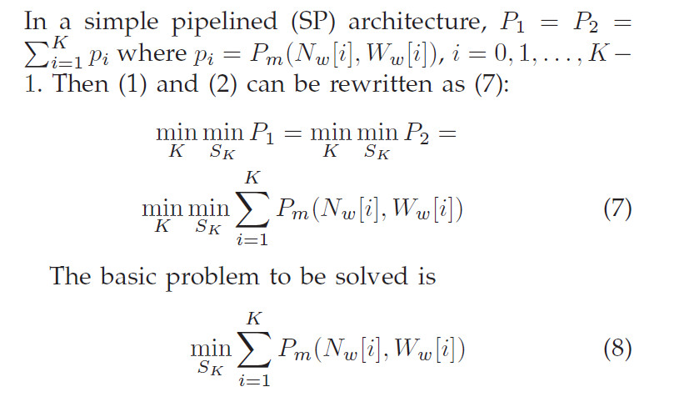
Problem of Power Minimization(SP)

Slide 13
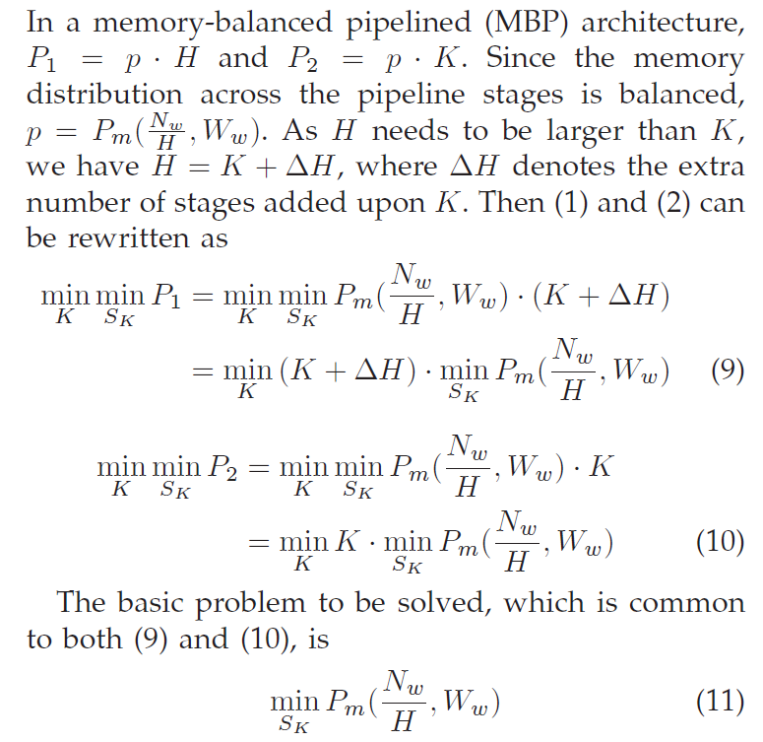

Problem of Power Minimization(MBP)

Slide 14

Solution techniques
In this section, we solve the three problems for two variants of multi-bit tries: the expanded trie and the tree bitmap (TBM) trie.
Lemma 1:
When the word width (Ww) is constant, the power dissipation of a single SRAM is minimized if and only if its memory size (M) is minimized.

Slide 15


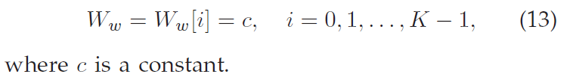
Power Minimization for Expanded Trie(1/4)
In an expanded trie, strides only affects Nw, while Ww is independent with the strides.

Slide 16

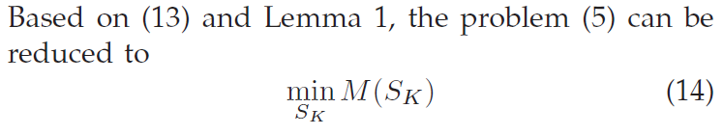
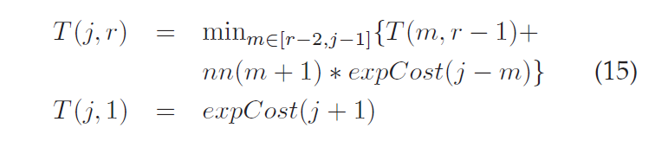
Power Minimization for Expanded Trie(2/4)
Solving the Problem for NP Architecture
  which is to find the optimal strides for building a minimum-memory K-level expanded trie.

Slide 17

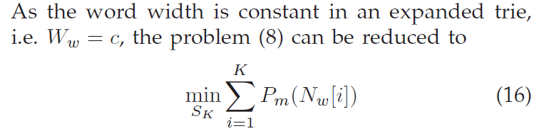

Power Minimization for Expanded Trie(3/4)
Solving the Problem for SP Architecture

Slide 18


Power Minimization for Expanded Trie(4/4)
Solving the Problem for MBP Architecture
  As Ww is constant in an expanded trie, the problem (11) can be reduced to (17)
  Thus the solution for MBP architecture is same as that for NP architecture.

Slide 19
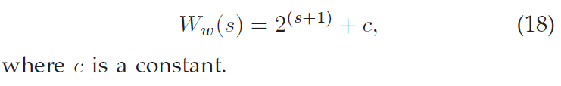
Power Minimization for TBM Trie(1/5)
There are two kinds of nodes in a TBM trie: internal nodes and end nodes. Both kinds of nodes have the same word width which can be represented as a function of s:
Notes:
Different from et, tbm word width is not inde to the strides

Slide 20
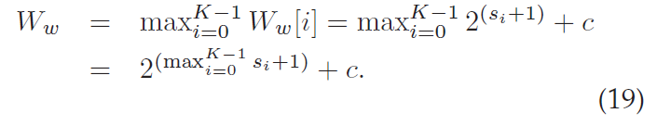
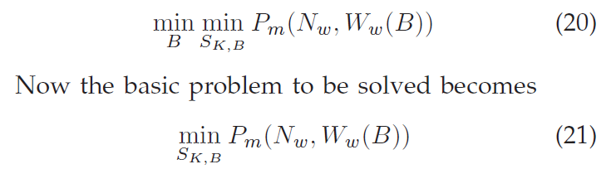
Power Minimization for TBM Trie(2/5)
Solving the Problem for NP Architecture
  The word width is determined by the largest stride.
the largest stride is unknown during the course of building the trie, it is difficult to evaluate the expansion cost if we use the similar dynamic programming recurrence as in previous sections. To solve the problem, we add a stride bound (B) .
  problem (5) can be transformed to

Slide 21


Power Minimization for TBM Trie(3/5)
Solving the Problem for NP Architecture
  Given a B, Ww is fixed to be 2B+1 + c . Thus similar to the case for the expanded trie , we can reduce the problem (21) to be the problem of minSK,B M(SK,B) .

Slide 22
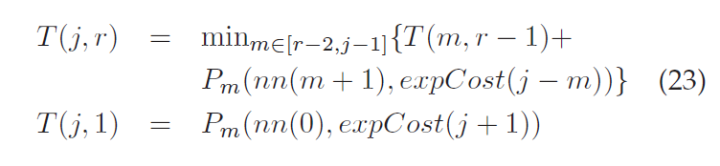
Power Minimization for TBM Trie(4/5)
Solving the Problem for SP Architecture
  the words stored in a same stage have the same word width. On the other hand, different stages can use different strides. Thus there is no need for the stride bound.

Slide 23
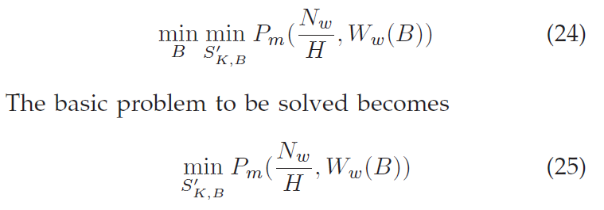

Power Minimization for TBM Trie(5/5)
Solving the Problem for MBP Architecture
  the problem (11) is transformed to be
  We can reduce the problem (25) to be the problem of

Slide 24
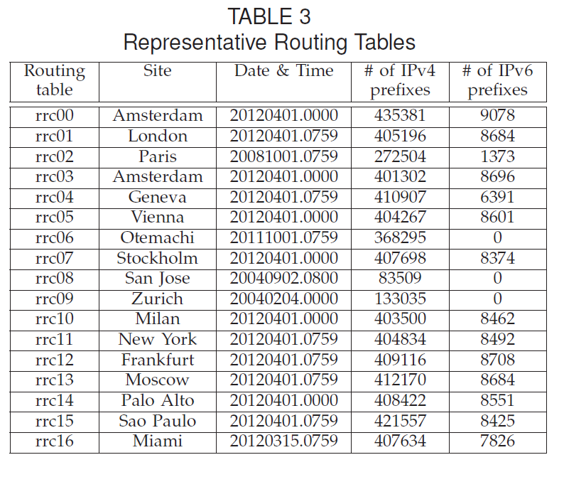

Slide 25
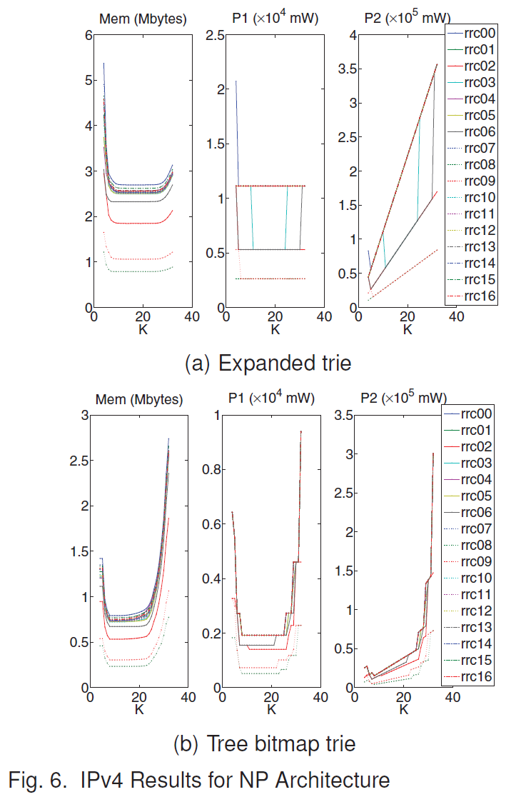
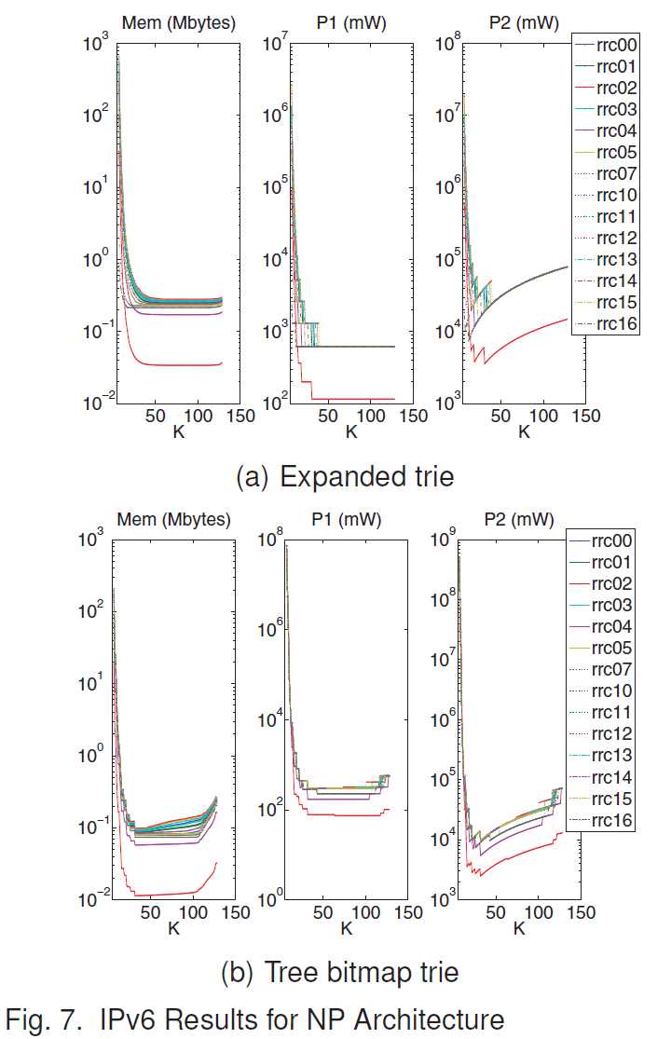

Slide 26
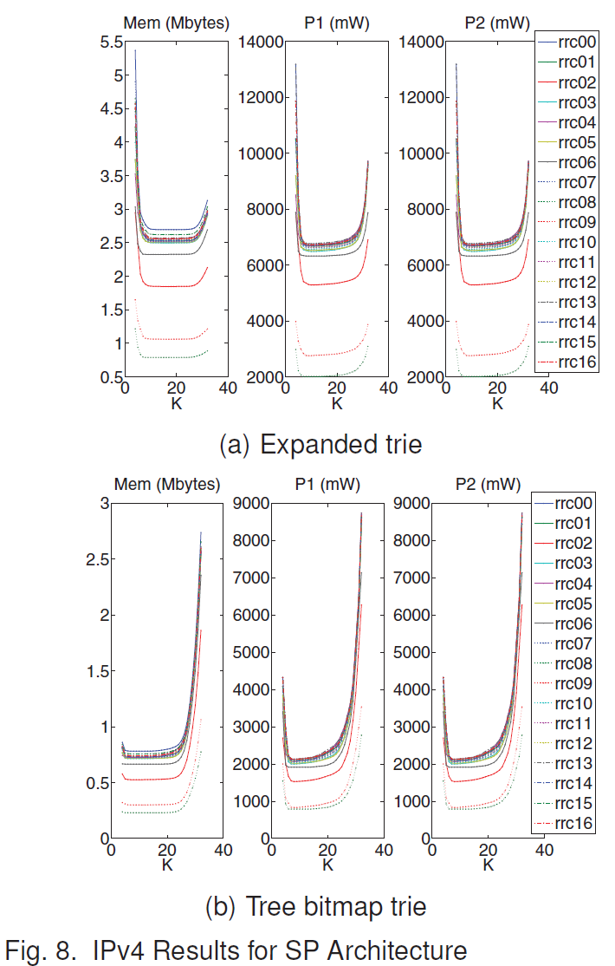
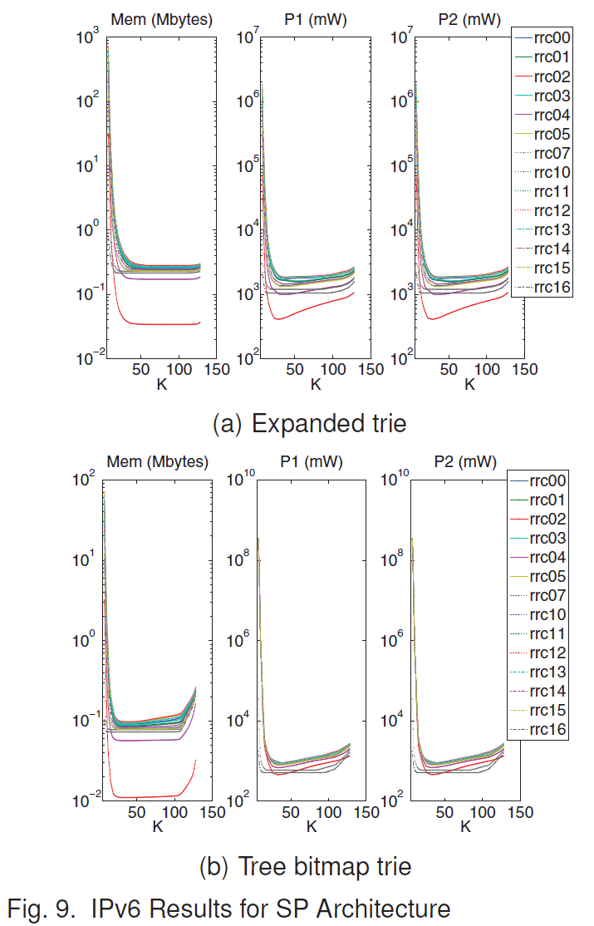

Slide 27
